Slide 1
Attribute Binding

Slide 2
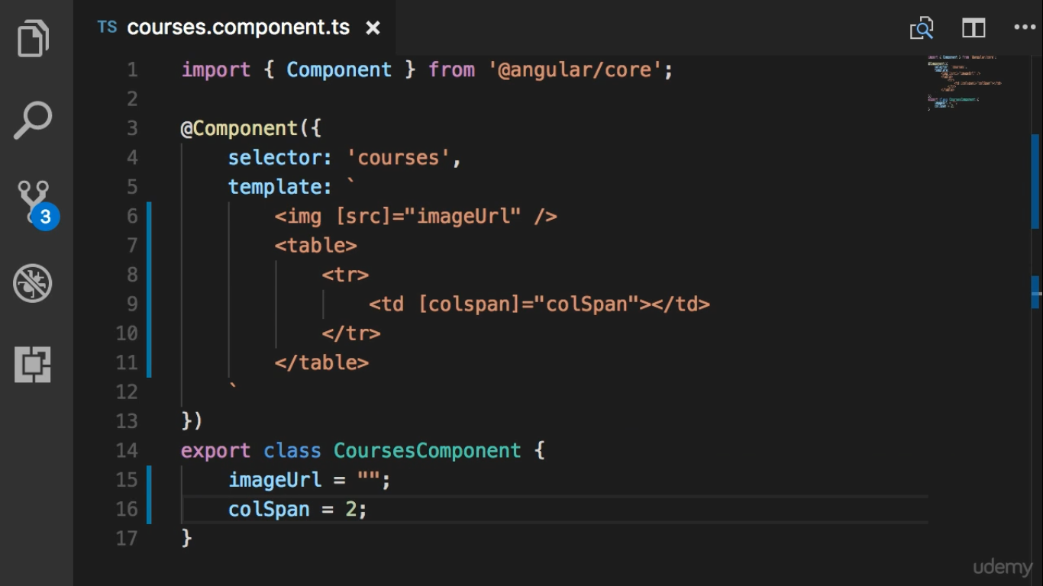

Slide 3


Slide 4
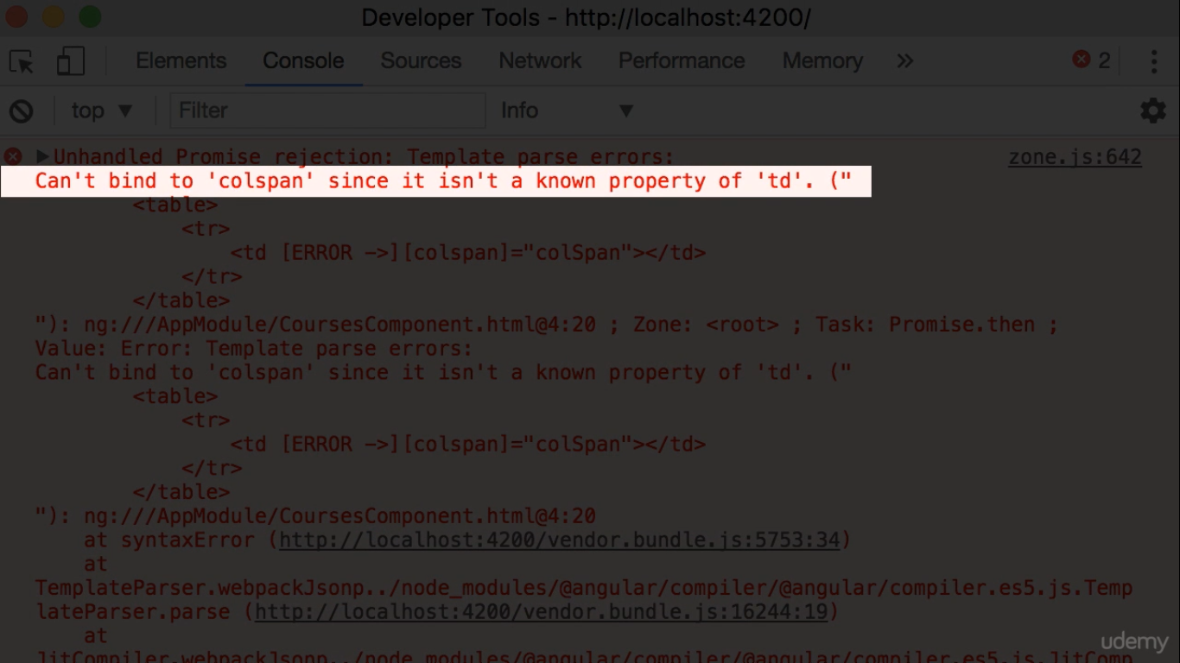

Slide 5
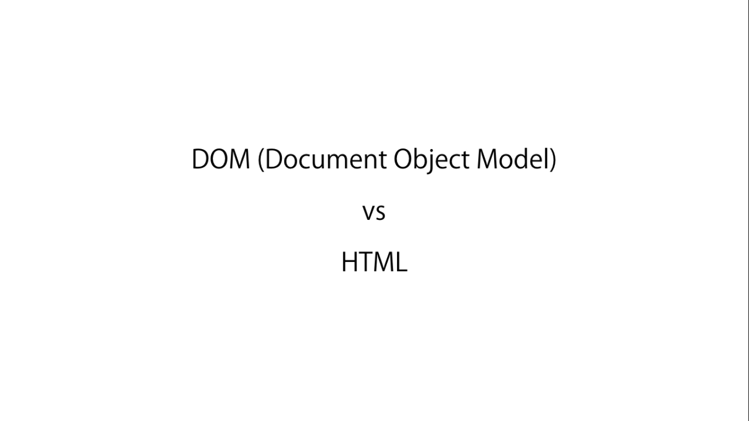

Slide 6
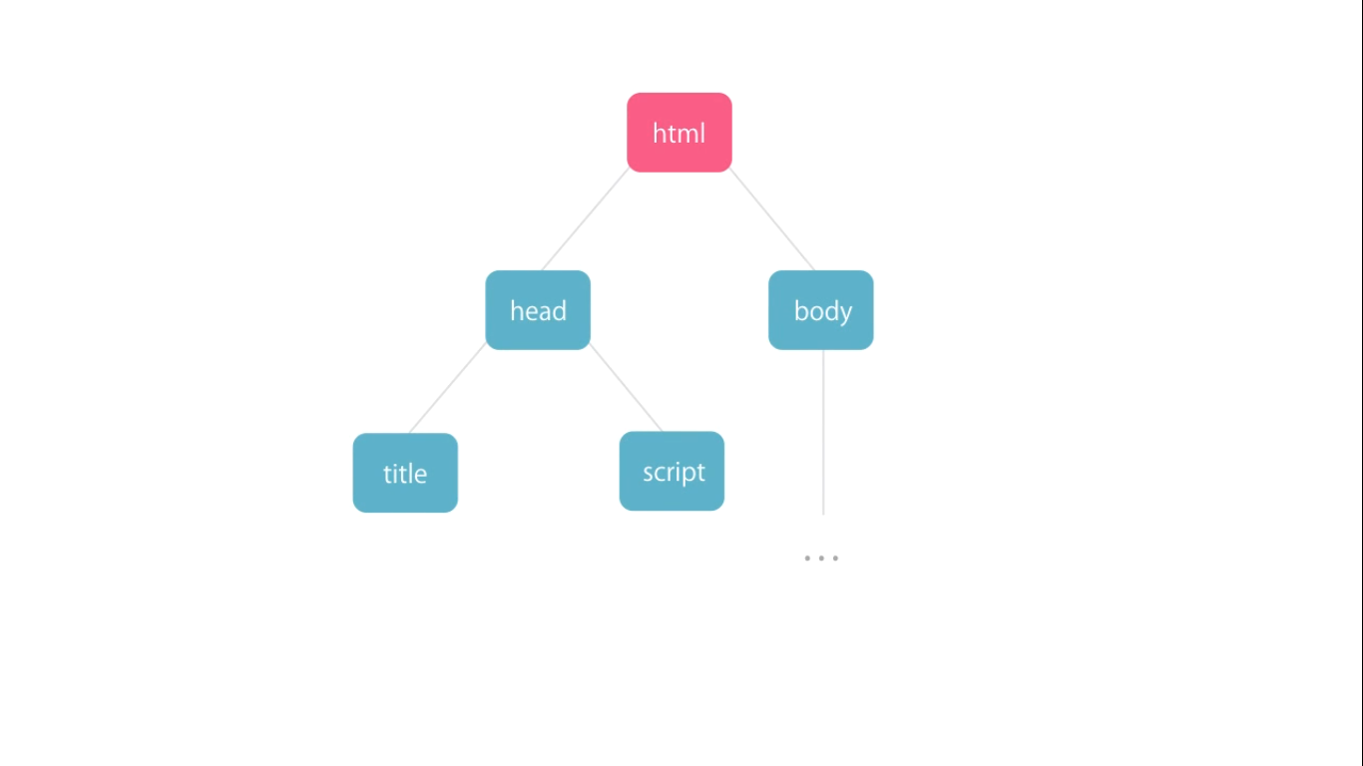

Slide 7


Slide 8
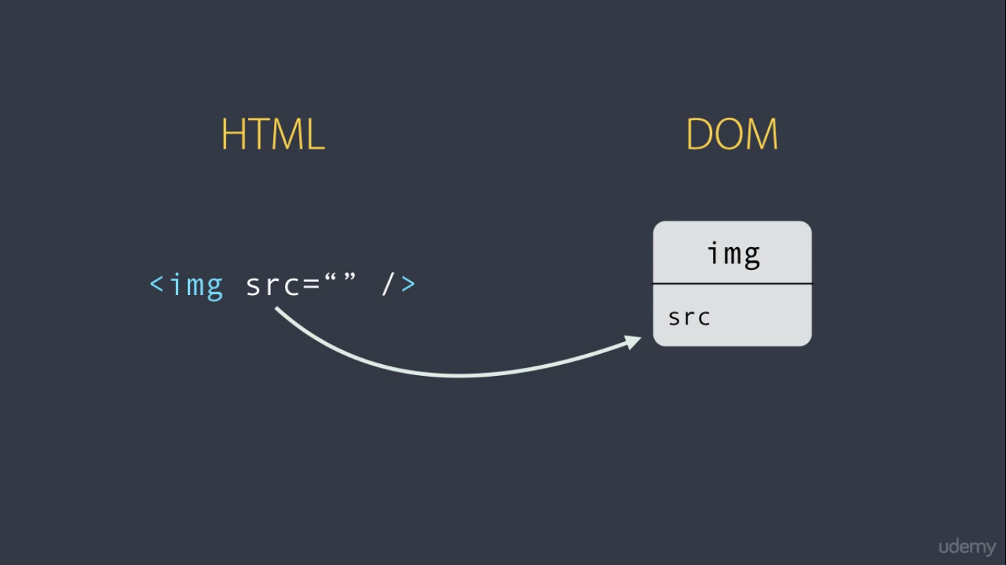
Most of HTML Elements have a One to One Mapping to Properties of DOM Object

Slide 9
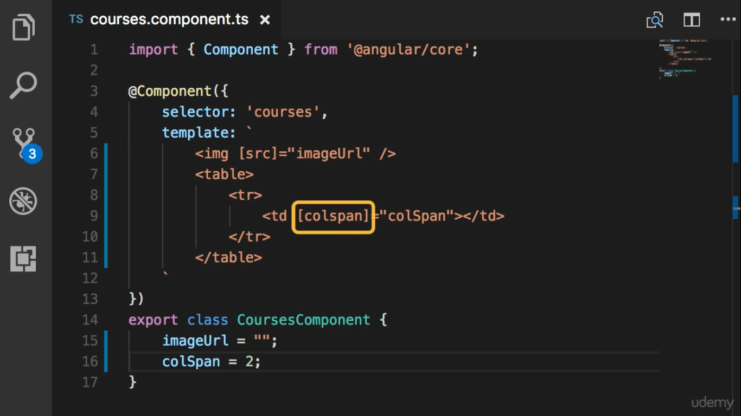
No Mapping

Slide 10
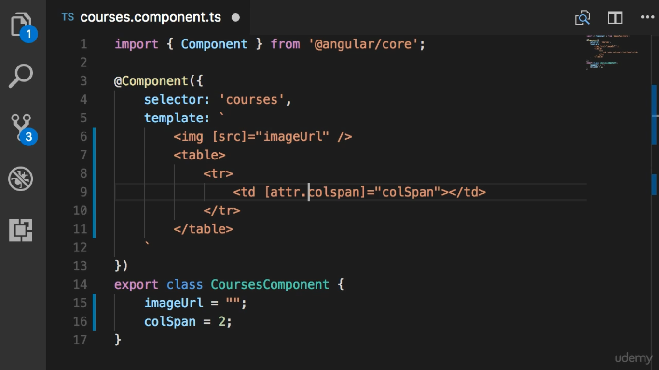

Slide 11
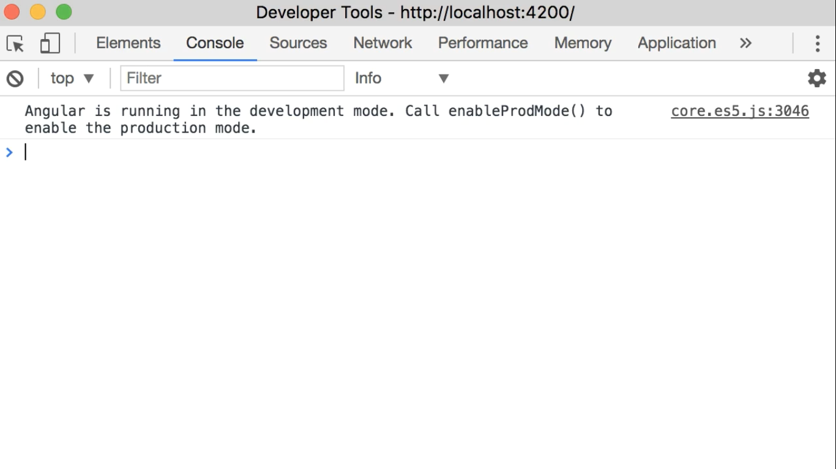
Don’t have Anymore Error

